Slide 1

from Team Bungee

Slide 2



The Problem
Accessibility
Carbon Footprint
Cost
It is hard to have a reach to private vehicles all the time.
Passenger vehicles emits considerable amount of carbon dioxide per year.
Total cost of owning a car always will increase. This could be from owner’s budget or Planet’s life.

Slide 3
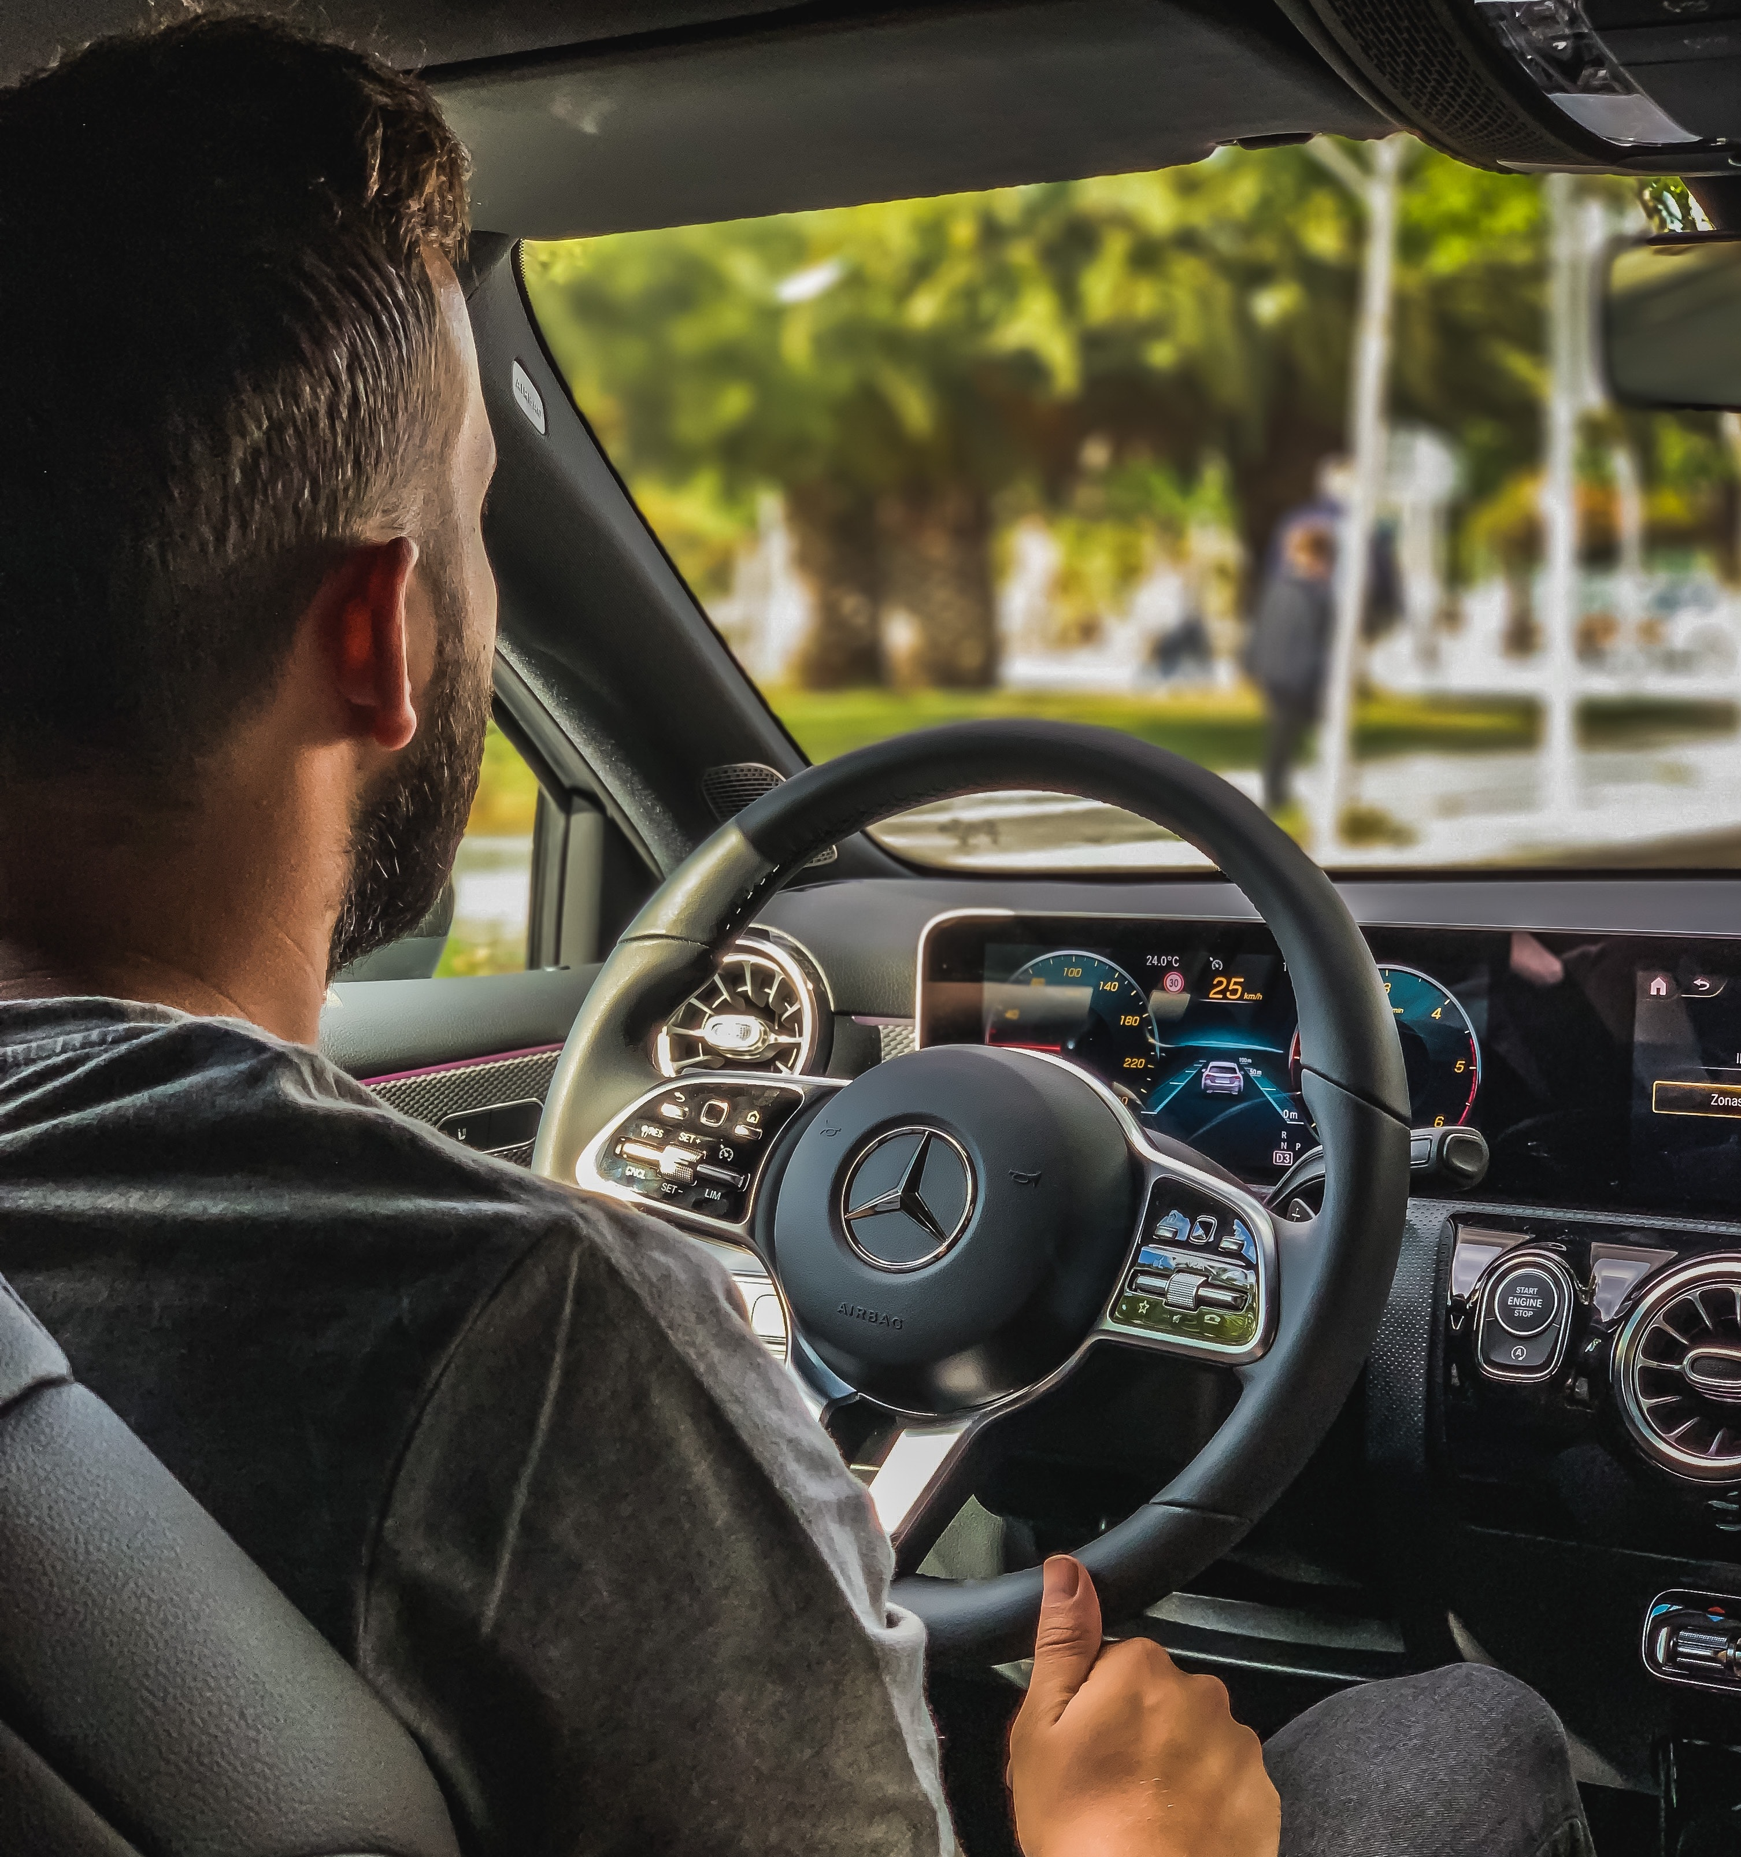
Persona 1 Car Owner & Driver
Needs & Expectations
Additional income with own vehicle.
Reduce carbon footprint by sharing car.
Pain Points
Always there will be a cost of car from different reasons.
John Doe
35
Works From Home
"Sharing my own car is a win on both side!"

Slide 4
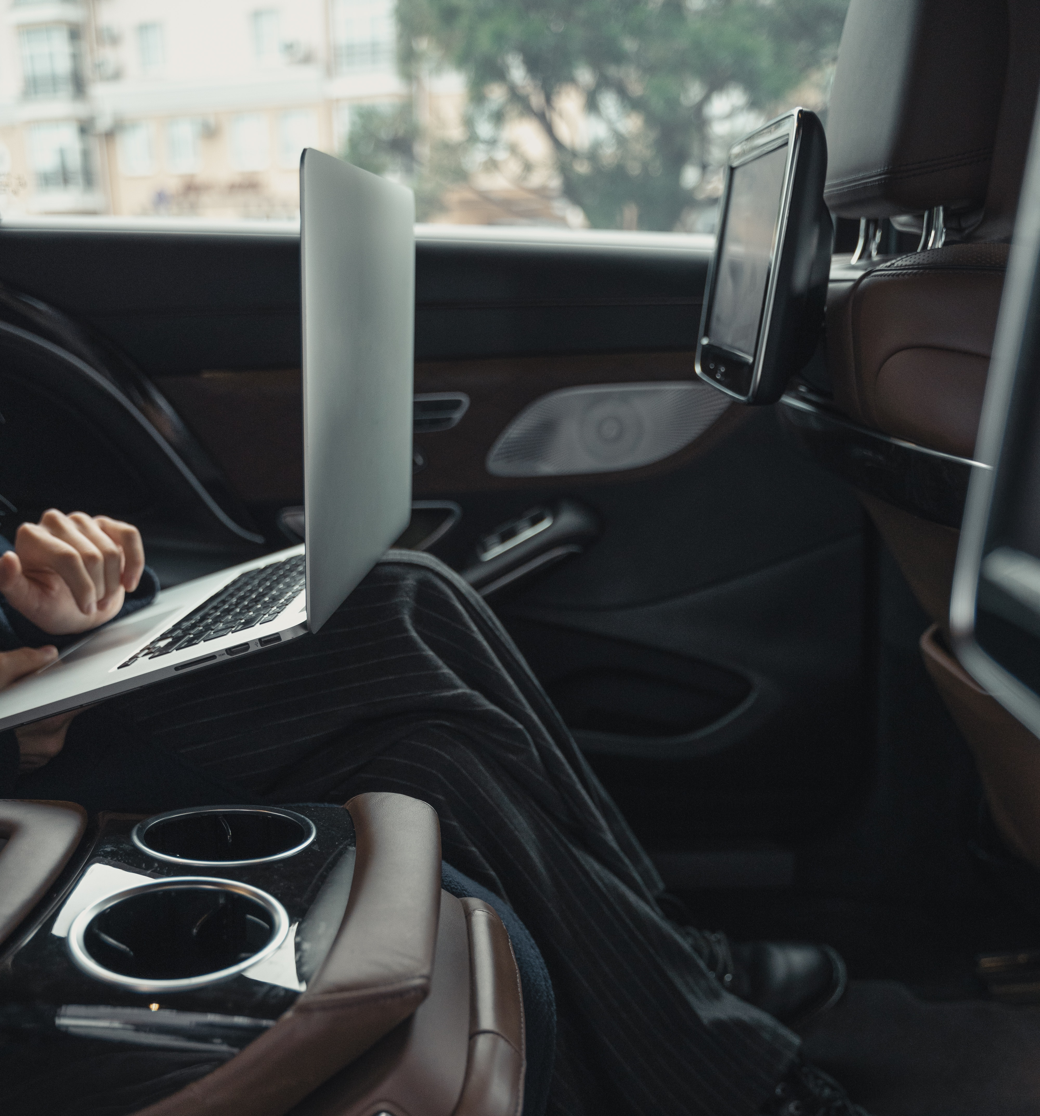
Persona 2 Passenger
Needs & Expectations
Cares about less crowded transportation.
Decreasing the carbon footprint.
Pain Points
Often no direct transportation on the airports.
Renting a car costs more and will not be used much.
Jake Doe
27
Travels Frequently
"Use car sharing for travels to other cities"

Slide 5
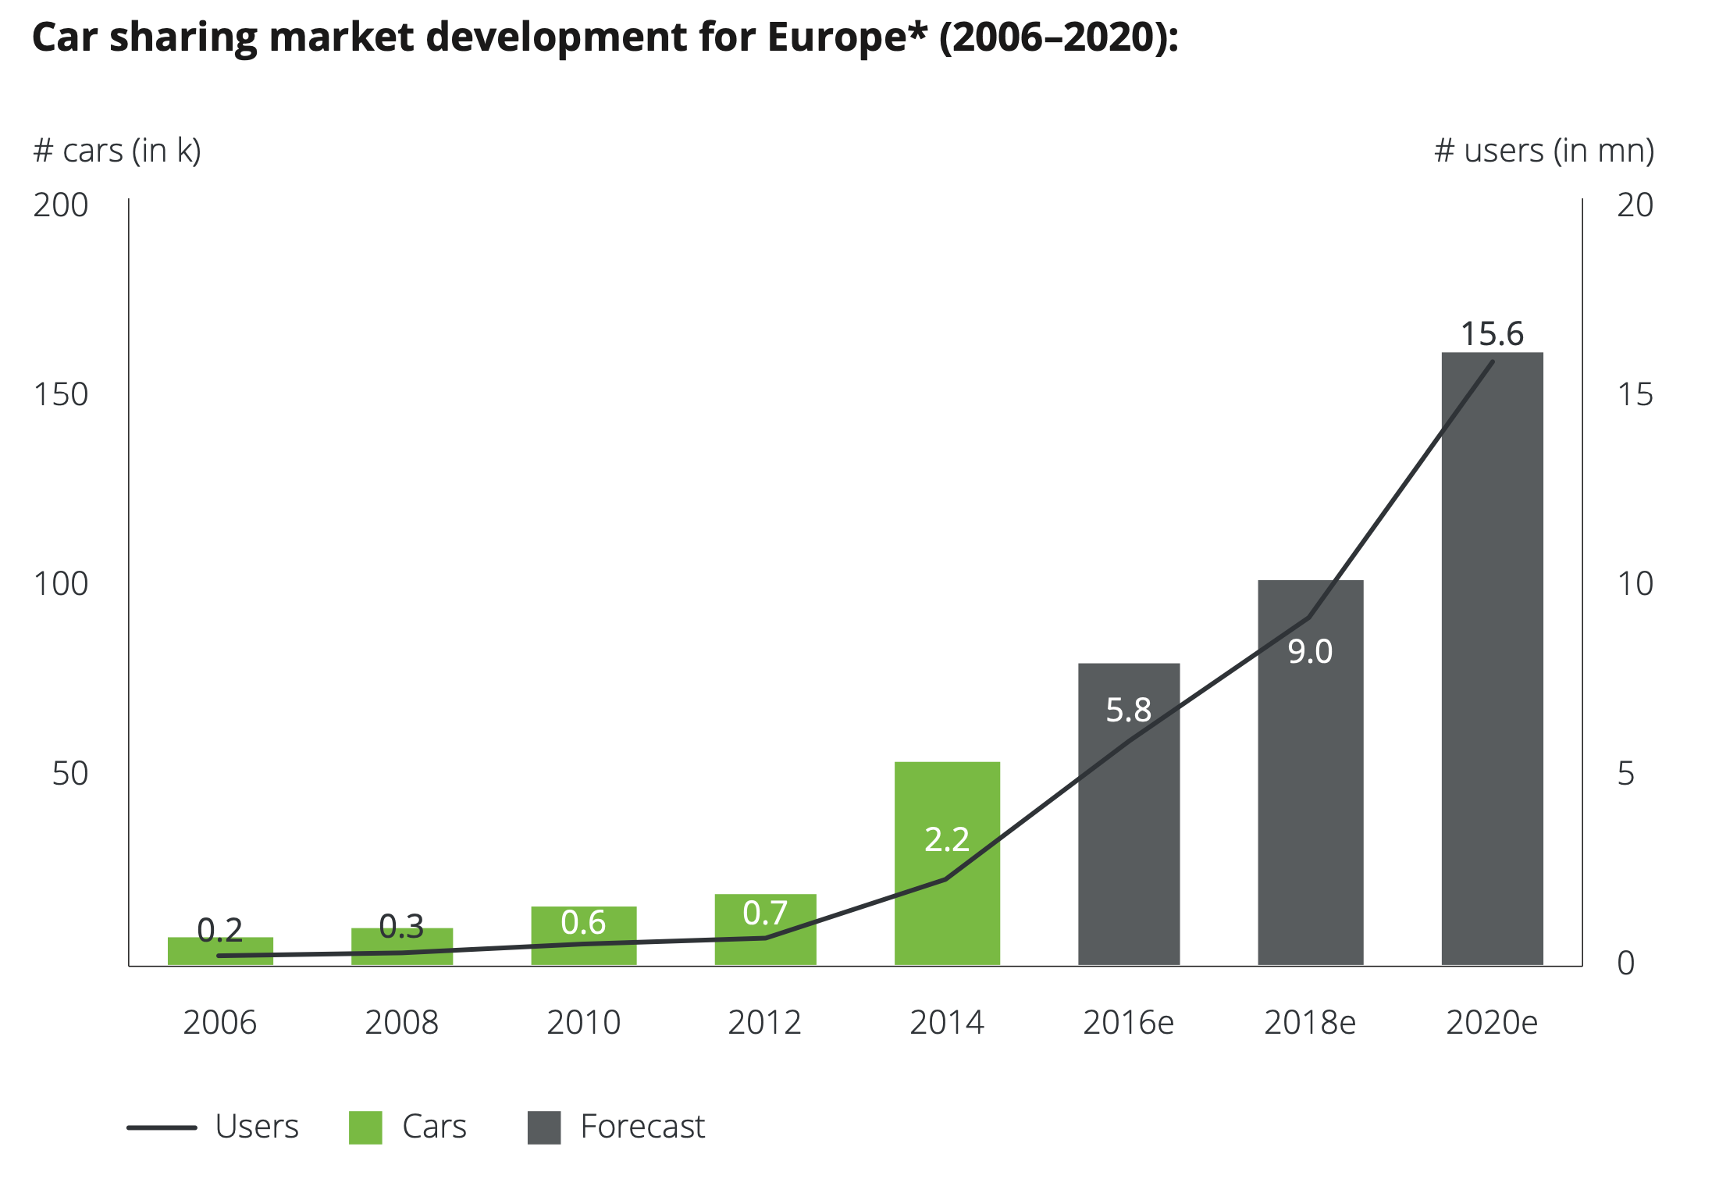
Road to sustainability
Maintaining the flexibility and mobility while trying to reduce total number of vehicles gave rise to idea of car-sharing.
The idea is booming, and the number of users in the car-sharing space is expected to reach 58,3 million by 2025 according to Statista.

Slide 6


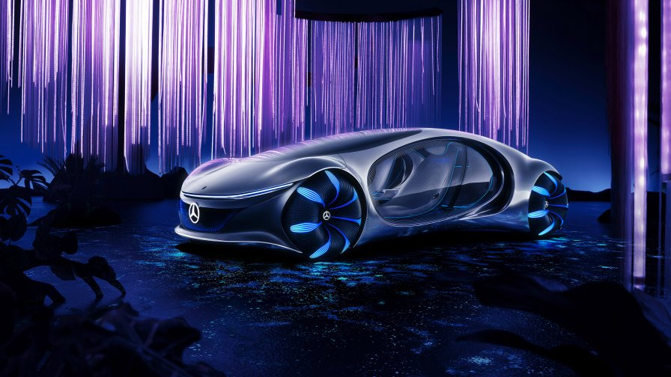

Our Proposition
MVP
Further Releases
Final Version
Initial product will allow users to book a ride from shown rings.
Further improvements and feature research will be executed. While the autonomous car rate goes up, user base for the service will also extended.
After the deployment of level 5 autonomous cars, dynamic routes that shapes with user request will be possible.
Revenue Projection:
Cost Expectation:
Commissions from each booking.
Loyalty service for those passenger and car owner.
Further data monetization collected from rides.
Development of the system.
Operation.

Slide 7
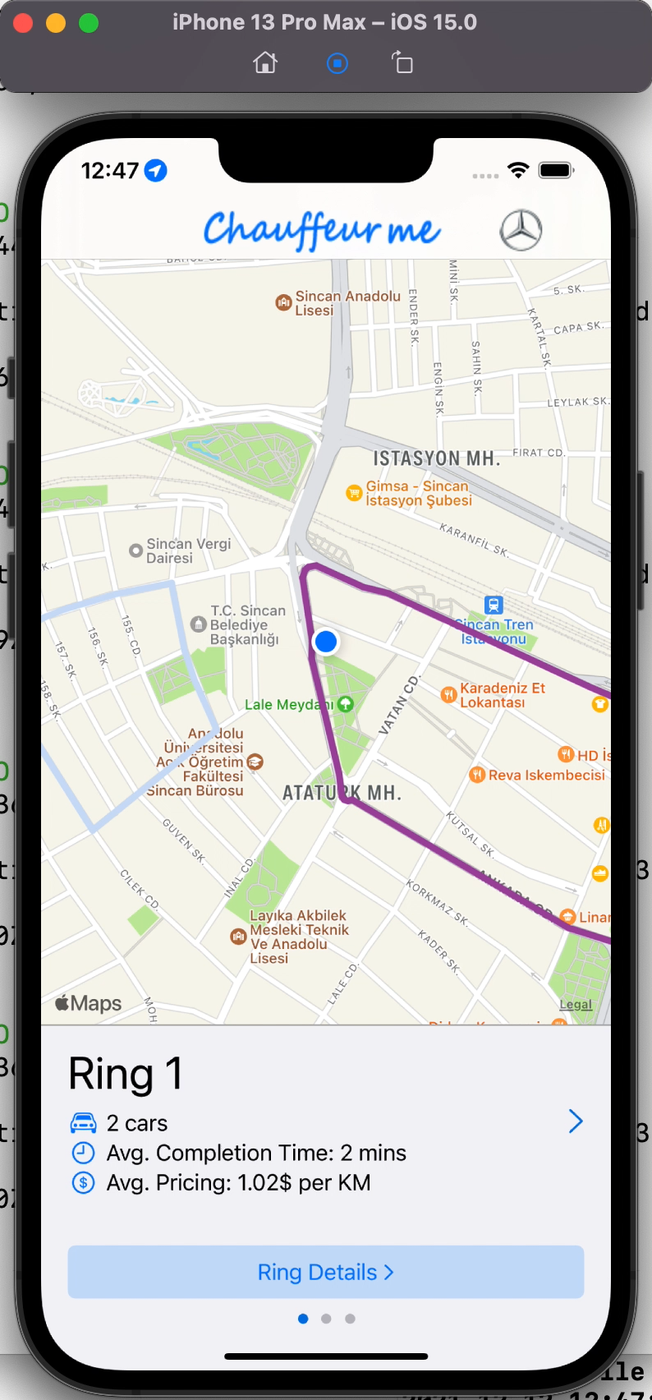
MVP Use Case Flow
Passenger chooses desired ring from main screen.
Hop in and drop out stations are selected.
Chooses desired time and number of seats.
Confirms booking and reserves the ride.
For frequent users, a loyalty program allows spending points and receiving discount.
Tech Stack:
Prisma ORM
Docker
PostgreSQL
ts.ED
NodeJS
Swift

Slide 8
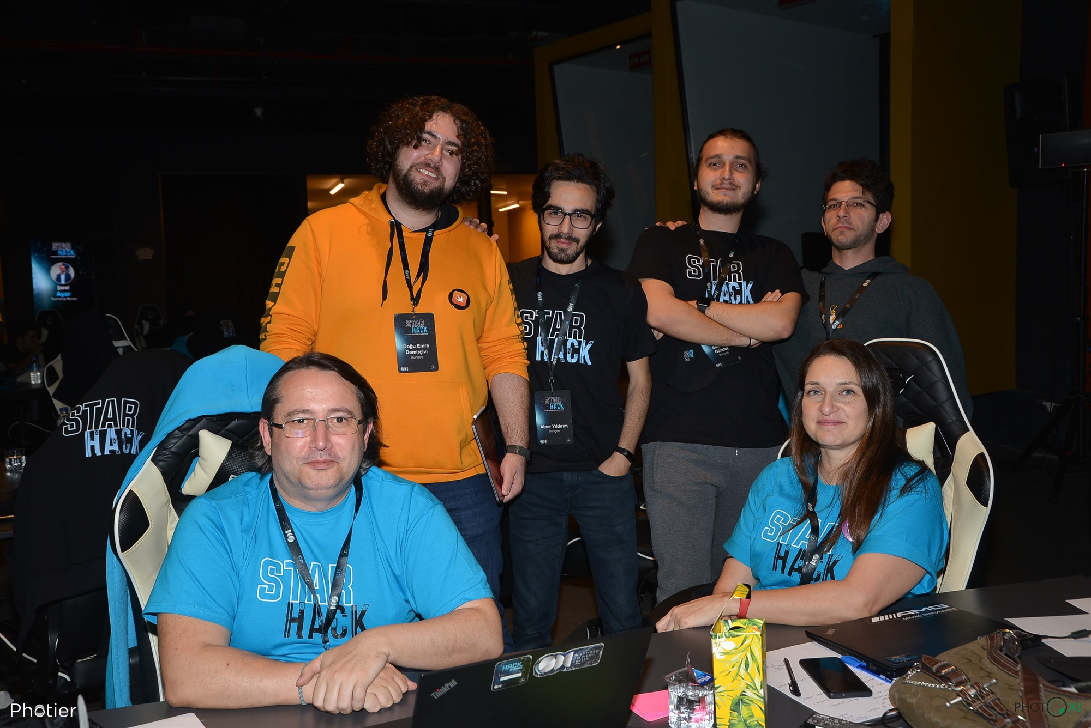
Thank You!

